Slide 1
British Airways Customer Reviews Analysis
Forage Task 1

Slide 2
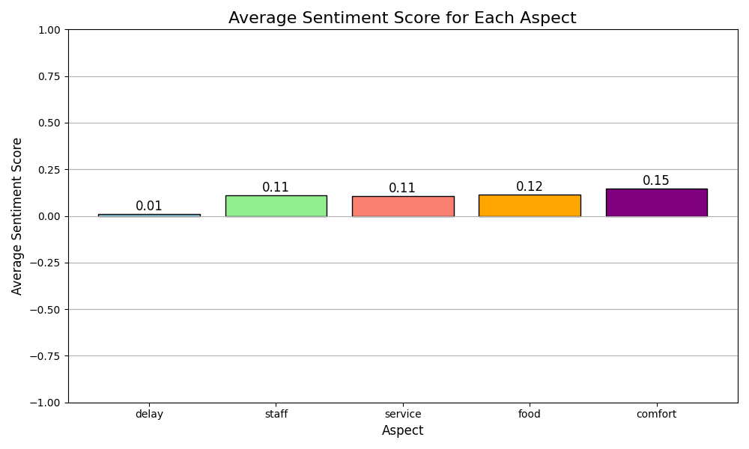
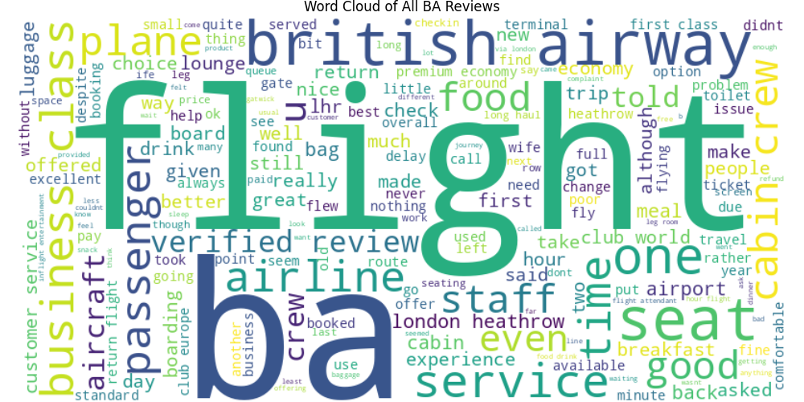
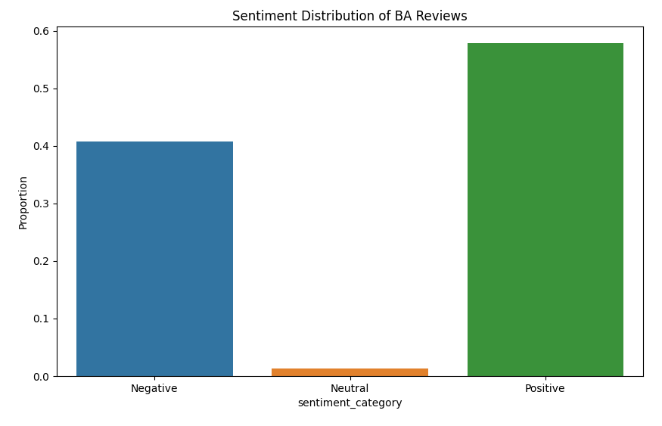
Key insights :
Overall positive sentiment (57.89%), but significant negative feedback (40.81%)
Comfort and Food received the highest positive sentiment scores, which means that British Airways is performing well in these areas.
Delay-related issues have the lowest sentiment score, indicating an area for improvement.
Top topics: Flight Experience, Airport Experience, Customer Service
Service Quality: Words most similar to 'service' include both positive (classy, best) and negative (bad, appalling) terms, suggesting mixed experiences with service quality.

